Slide 1

Numerical Differentiation with Python

Slide 2
The Derivative
The derivative of a function 𝑦 = 𝑓(𝑥) is a measure of how 𝑦 changes with 𝑥
The derivative of a function 𝑓(𝑥) is denoted ^{𝑑ƒ(𝑥)}
𝑑x
We have the following definition:
Secant
𝑑𝑓(𝑥) 𝑓 𝑥 + ℎ − 𝑓(𝑥)
𝑓(𝑥 + ℎ)
= lim
𝑑𝑥
h→0
ℎ
𝑓(𝑥)
Different notation is used:
𝑥
𝑥 + ℎ
𝑑𝑓(𝑥)
ℎ
= 𝑦'(𝑥) = 𝑦̇(𝑥)
𝑑𝑥

Slide 3
The Derivative
𝑓(𝑥)
The derivative of a function of a single variable at a chosen input value, when it exists, is the slope of the tangent line to the graph of the function at that point.
Tangent line
Example:
𝑓 𝑥
𝑑𝑓(𝑥 )
i
𝑑𝑥
= 𝑥²
𝑓(𝑥_{i})
𝑑𝑓(𝑥)
𝑥
= 2𝑥
𝑑𝑥
𝑑𝑓(2)
𝑥_{i}
𝑥 = 2
https://en.wikipedia.org/wiki/Derivative
= 2×2 = 4
𝑑𝑥

Slide 4
Derivative Rules
There are many derivative rules (as you probably know from mathematics courses)
We will focus on the the basic rule:
𝑓 𝑥 = 𝑘𝑥^{𝑛}
^{𝑑𝑓(𝑥)} = 𝑘 𝑛 𝑥^{𝑛-1}
𝑑𝑥
Example:
𝑓 𝑥 = 4𝑥³
^{𝑑𝑓(𝑥)} = 4×3𝑥² = 12𝑥²
𝑑𝑥
^{𝑑𝑓(3)} = 12×3² = 12×9 = 108
𝑑𝑥

Slide 5
Basic Numerical Approach
A numerical approach to the derivative of a function 𝑦 = 𝑓(𝑥) is:
y₂
𝑓(𝑥 + ℎ)
y₁
𝑓(𝑥)
𝑥
𝑥 + ℎ
ℎ

Slide 6
Example
𝑑𝑦 _{=?}
𝑦 𝑥 = 𝑥²
𝑑𝑥
𝑑𝑦
We know for this simple example that the exact analytical solution is: Given the following values:
_{𝑑𝑥} = 2𝑥
x | y
-2 | 4
-1 | 1
0 | 0
1 | 1
2 | 4
^{𝑑𝑦} 𝑥 = −2 = −4
𝑑𝑥
^{𝑑𝑦} 𝑥 = −1 = −2
Let's use Python to see if we get the same values?
𝑑𝑥
^{𝑑𝑦} 𝑥 = 0 = 0
𝑑𝑥
𝑑𝑦
_{𝑑𝑥} 𝑥 = 1 = 2
^{𝑑𝑦} 𝑥 = 2 = 4
𝑑𝑥
𝑑𝑦 _{=2x}
𝑑𝑥

Slide 7

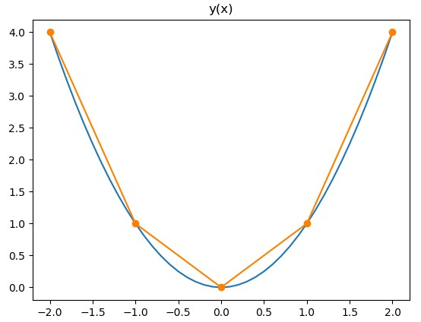
Python Code
import numpy as np
import matplotlib.pyplot as plt
xstart = -2
xstop = 2.1
increment = 0.1
x = np.arange(xstart,xstop,increment)
y = x**2
plt.plot(x,y)
xstart = -2
xstop = 3
increment = 1
x = np.arange(xstart,xstop,increment)
y = x**2;
plt.plot(x,y, '-o')
plt.title("y(x)")
We start to plot the function:
𝑦 𝑥 = 𝑥²
We use the following data points:
Resulting plot:
x | y
-2 | 4
-1 | 1
0 | 0
1 | 1
2 | 4

Slide 8
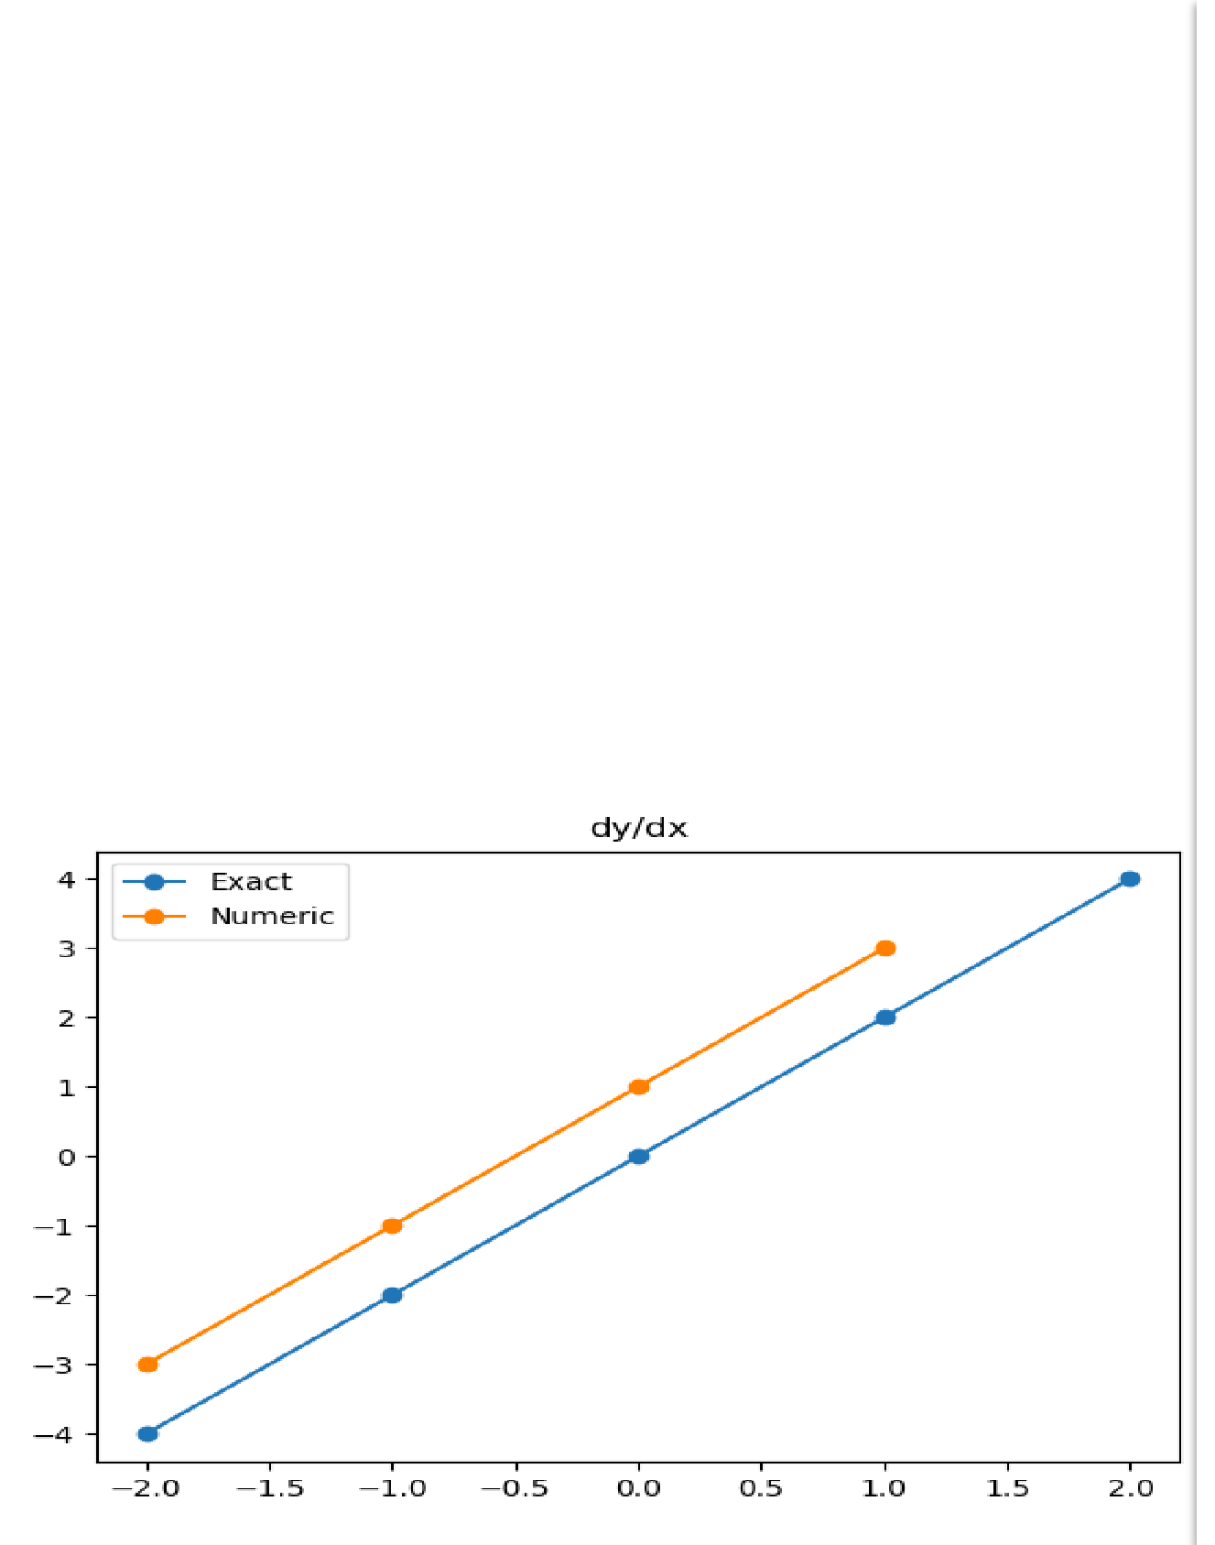

Python Code
import numpy as np
import matplotlib.pyplot as plt
xstart = -2
xstop = 3
increment = 1
x = np.arange(xstart,xstop,increment)
We will use numerical differentiation to find _{𝑑𝑥} for the following function:
𝑑𝑦
y = x**2;
𝑦 𝑥
We use the following data points:
# Exact/Analytical Solution dydx_exact = 2*x
= 𝑥²
print("dydx_exact=", dydx_exact)
Results:
plt.plot(x, dydx_exact, 'o-')
x | dy/dx
-2
-1
0
1
2
# Numerical Solution
dydx_num = np.diff(y) / np.diff(x);
print("dydx_num", dydx_num)
xstart = -2
xstop = 2
x = np.arange(xstart,xstop,increment)
dydx_exact= [-4 -2
dydx_num [-3. -1.
0 2 4]
1. 3.]
plt.plot(x, dydx_num, 'o-') plt.title("dy/dx") plt.legend(["Exact", "Numeric"])

Slide 9
Comments to the Results

Slide 10
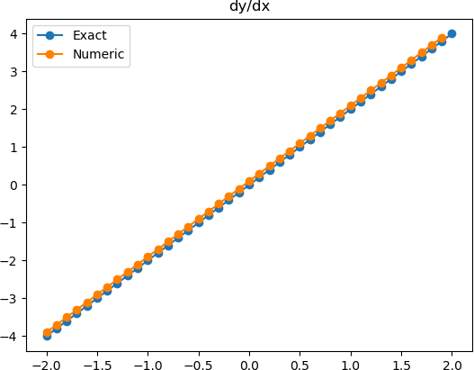
Python Code
import numpy as np
import matplotlib.pyplot as plt
xstart = -2
xstop = 2.1
increment = 0.1
We increase number of data points to see if we get better results
Previously: x = -2,-1,0,1,2
Now: x = -2.0,-1.9, -1.8, … 0, 0.1,
x = np.arange(xstart,xstop,increment)
y = x**2;
# Exact/Analytical Solution dydx_exact = 2*x
print("dydx_exact=", dydx_exact) plt.plot(x, dydx_exact, 'o-')
# Numerical Solution
dydx_num = np.diff(y) / np.diff(x);
print("dydx_num", dydx_num) xstart = -2
xstop = 2
x2 = np.arange(xstart,xstop,increment)
plt.plot(x2, dydx_num, 'o-') plt.title("dy/dx") plt.legend(["Exact", "Numeric"])

Slide 11
Comments to the Results
𝑑𝑓(𝑥) _{= lim} 𝑓 𝑥 + ℎ − 𝑓(𝑥)
𝑑𝑥 ℎ
h→0
𝑑𝑦 ≈ ∆𝑦 ₌ 𝑦₂ − 𝑦₁
𝑑𝑥 ∆𝑥 𝑥₂ − 𝑥₁
We see that the numeric solutions becomes very close to the exact solutions.
When ℎ → 0 we should expect that the numerical solutions should exactly match the exact solutions.

Slide 12
Polynomials
A polynomial is expressed as:
𝑝 𝑥 = 𝑝₁𝑥^{𝑛} + 𝑝₂𝑥^{𝑛-1} + ⋯ + 𝑝_{𝑛}𝑥 + 𝑝_{𝑛+1}
where 𝑝₁, 𝑝₂, 𝑝₃, … are the coefficients of the polynomial.
In Python we can use the polyder() function to perform differentiation on polynomials.
This function works the same way as the polyint()
function which performs integration on polynomials.

Slide 13
Example
Given the following polynomial:
𝑝(𝑥) = 𝑥³ + 2𝑥² − 𝑥 + 3
Note!!! In order to use it in Python, we reformulate:
𝑝(𝑥) = 3 −𝑥 + 2𝑥²+ 𝑥³
We find:
^{𝑑𝑝(𝑥)} = 0 − 1 + 4𝑥 + 3𝑥² = −1 + 4𝑥 + 3𝑥²
𝑑x

Slide 14
Python
𝑝 𝑥 = 3 −𝑥 + 2𝑥²+ 𝑥³
import numpy.polynomial.polynomial as poly
p = [3, -1, 2, 1]
dpdx = poly.polyder(p)
print("dpdx =", dpdx))
The Python solution:
= −1 + 4𝑥 + 3𝑥² dpdx = [-1. 4. 3.]
We see that the Python script gives the correct answer!
𝑑𝑝(𝑥)
𝑑𝑥

Slide 15



Another Python Example
Given the Polynomial:
𝑝 𝑥 = 2 + 𝑥³
We need to reformulate to make it work with Python:
import numpy.polynomial.polynomial as
p = [2, 0, 0, 1]
poly
dpdx = np.polyder(p)
print("dpdx =", dpdx)
We see that the Python script gives the correct answer!

Slide 16
Finite difference approximations

Slide 17
Motivation
How do you evaluate the derivative of a tabulated function.
How do we determine the velocity and acceleration from tabulated measurements.
Time (second) | Displacement (meters)
0 | 30.1
5 | 48.2
10 | 50.0
15 | 40.2

Slide 18
Three Formula

Slide 19
Taylor Series
Taylor series are expansions of a function f(x) for some
finite distance dx to f(x+dx)
What happens, if we use this expression for
?

Slide 20

Forward/Backward Difference Formula
$$dx$$

Slide 21
Central Difference Formula

Slide 22
The Three Formula (Revisited)

Slide 23
Higher Order Formulas

Slide 24
Higher Order Formulas

Slide 25
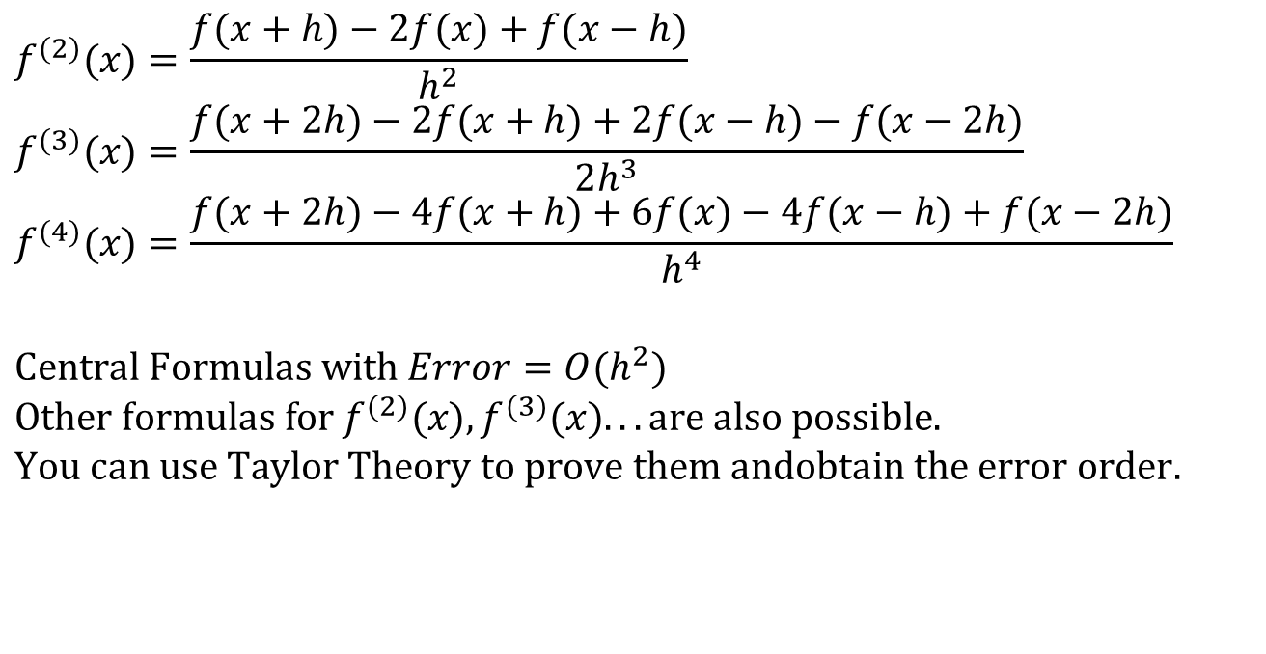
Other Higher Order Formulas
$$f^{(2)}(x)=\frac{f(x+h)−2f(x)+f(x−h)}{h^{2}} \\ f^{(3)}(x)=\frac{f(x+2h)−2f(x+h)+2f(x−h)−f(x−2h)}{2h^{3}} \\ f^{(4)}(x)=\frac{f(x+2h)−4f(x+h)+6f(x)−4f(x−h)+f(x−2h)}{h^{4}}$$ $$\text{Central} \text{Formulas} \text{with} Error=O(h^{2}) \\ \text{Other} \text{formulas} \text{for} f^{(2)}(x),f^{(3)}(x)...\text{are} \text{also} \text{possible}\text{.} \\ \text{You} \text{can} \text{use} \text{Taylor} \text{Theor}\text{y} \text{to} \text{prove} \text{them} \text{andobtain} \text{the} \text{error} \text{order}.$$

Slide 26
Example
Use forward, backward and centered difference approximations to estimate the first derivate of:
f(x) = –0.1x⁴ – 0.15x³ – 0.5x² – 0.25x + 1.2
at x = 0.5 using step size h = 0.5 and h = 0.25
Note that the derivate can be obtained directly:
f’(x) = –0.4x³ – 0.45x² – 1.0x – 0.25
The true value of f’(0.5) = -0.9125
In this example, the function and its derivate are known. However, in general, only tabulated data might be given.

Slide 27
Solution with Step Size = 0.5
f(0.5) = 0.925, f(0) = 1.2, f(1.0) = 0.2
Forward Divided Difference:
f’(0.5) ≈ (0.2 – 0.925)/0.5 = -1.45
|ε_{t}| = |(-0.9125+1.45)/-0.9125| = 58.9%
Backward Divided Difference:
f’(0.5) ≈ (0.925 – 1.2)/0.5 = -0.55
|ε_{t}| = |(-0.9125+0.55)/-0.9125| = 39.7%
Centered Divided Difference:
f’(0.5) ≈ (0.2 – 1.2)/1.0 = -1.0
|ε_{t}| = |(-0.9125+1.0)/-0.9125| = 9.6%

Slide 28
Solution with Step Size = 0.25
f(0.5)=0.925, f(0.25)=1.1035, f(0.75)=0.6363
Forward Divided Difference:
f’(0.5) ≈ (0.6363 – 0.925)/0.25 = -1.155
|ε_{t}| = |(-0.9125+1.155)/-0.9125| = 26.5%
Backward Divided Difference:
f’(0.5) ≈ (0.925 – 1.1035)/0.25 = -0.714
|ε_{t}| = |(-0.9125+0.714)/-0.9125| = 21.7%
Centered Divided Difference:
f’(0.5) ≈ (0.6363 – 1.1035)/0.5 = -0.934
|ε_{t}| = |(-0.9125+0.934)/-0.9125| = 2.4%

Slide 29
Discussion
For both the Forward and Backward difference, the error is O(h)
Halving the step size h approximately halves the error of the Forward and Backward differences
The Centered difference approximation is more accurate than the Forward and Backward differences because the error is O(h²)
Halving the step size h approximately quarters the error of the Centered difference.

Slide 30
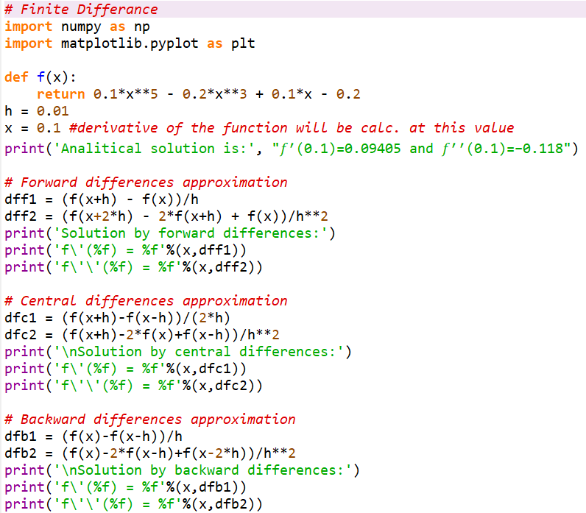
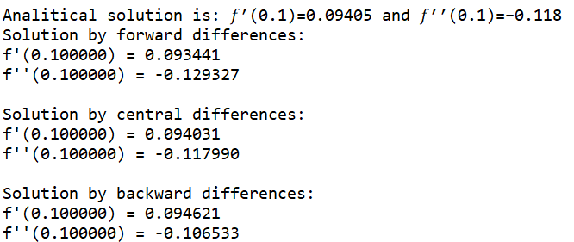

Slide 31
Richardson Extrapolation

Slide 32

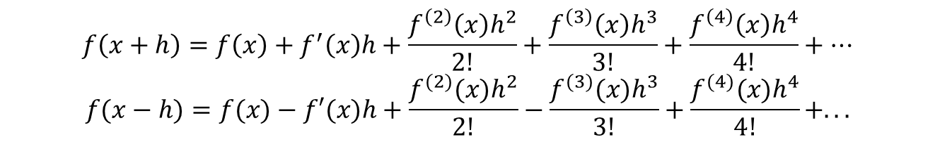
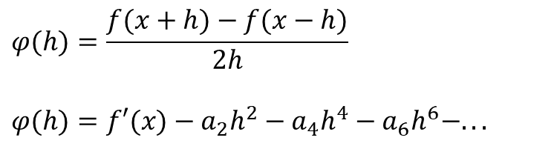
Richardson Extrapolation
$$\text{CentralDifference}\text{:} f′(x)=\frac{f(x+h)−f(x−h)}{2h}+O(h^{2})$$
$$\text{Can} \text{we} \text{get} \text{a} \text{better} \text{formula}\text{?}$$
$$f\left(x+h\right)=f\left(x\right)+f^{′}\left(x\right)h+\frac{f^{\left(2\right)}\left(x\right)h^{2}}{2!}+\frac{f^{\left(3\right)}\left(x\right)h^{3}}{3!}+\frac{f^{\left(4\right)}\left(x\right)h^{4}}{4!}+…$$
$$f(x−h)=f(x)−f′(x)h+\frac{f^{(2)}(x)h^{2}}{2!}−\frac{f^{(3)}(x)h^{3}}{3!}+\frac{f^{(4)}(x)h^{4}}{4!}+...$$
Every even-power term cancels when computing f(x + h) - f(x - h), and so
$$φ(h)=\frac{f(x+h)−f(x−h)}{2h}$$
$$φ(h)=f′(x)−a_{2}h^{2}−a_{4}h^{4}−a_{6}h^{6}−...$$

Slide 33
Richardson Extrapolation
Use two derivate estimates to compute a third, more accurate approximation

Slide 34
Richardson Extrapolation Example
Use the function:
f(x) = –0.1x⁴ – 0.15x³ – 0.5x² – 0.25x + 1.2
Starting with h₁ = 0.5 and h₂ = 0.25, compute an improved estimate of f’(0.5) using Richardson Extrapolation
Recall the true value of f’(0.5) = -0.9125

Slide 35
Solution
The first-derivative estimates can be computed with centered differences as:

Slide 36
Richardson Extrapolation Table
D(0,0)=Φ(h)
D(1,0)=Φ(h/2) | D(1,1)
D(2,0)=Φ(h/4) | D(2,1) | D(2,2)
D(3,0)=Φ(h/8) | D(3,1) | D(3,2) | D(3,3)

Slide 37
Richardson Extrapolation Table

Slide 38
Example

Slide 39
Example First Column

Slide 40
Example Richardson Table

Slide 41
Example Richardson Table
1.08483
1.08988 | 1.09156
1.09115 | 1.09157 | 1.09157
This is the best estimate of the derivative of the function.
All entries of the Richardson table are estimates of the derivative of the function.
The first column are estimates using the central difference formula with different step size h.

Slide 42
